Slide 1


Introduction to Databases Data Definition and Data Types
How do RDBMS work?
Managing DBs using IDEs
Intro to
DB

Slide 2

Table of Contents
Data Management
Database Engine
Table Relationships
Programmability
Data Types
Database Modeling
Basic SQL Queries and Table Customization
Deleting Data and Structures

Slide 3

Data Management
When Do We Need a Database?

Slide 4
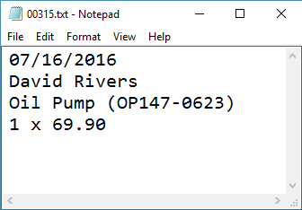
Storage vs. Management
Conventional Data Storage
Notes
Receipts
SALES RECEIPT
Date: 07/16/2016
Order#: [00315]
Customer: David Rivers
Product: Oil Pump
S/N: OP147-0623
Unit Price: 69.90
Qty: 1
Total: 69.90

Slide 5
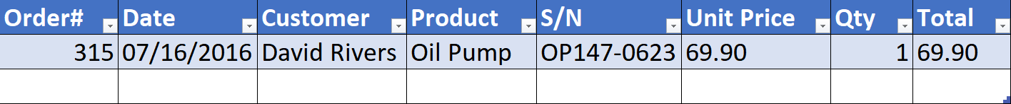
Storage vs. Management (2)
We can group related pieces of data into separate columns

Slide 6

Storage vs. Management (3)
Storing data is not the primary reason to use a Database
Flat storage eventually runs into issues with
Size
Ease of updating
Accuracy
Security
Redundancy
Importance

Slide 7
Databases and RDBMS
A database is an organized collection of information
It imposes rules on the contained data
Relational storage first proposed by Edgar Codd in 1970
A Relational Data Base Management System provides tools to manage the database
It parses requests from the user and takes the appropriate action
The user doesn't have direct access to the stored data

Slide 8


Database Engines

Slide 9





Database Engine Flow
SQL Server uses the Client-Server Model
Clients
Query
Engine
Access
Database
Data
Data

Slide 10


Download Clients & Servers
Download SQL Server Express Edition from Microsoft
Download SQL Server Management Studio separately
http://aka.ms/sqlserver2017
http://aka.ms/ssms

Slide 11
SQL Server Architecture
Logical Storage
Instance
Database
Schema
Table
Physical Storage
Data Files and Log files
Data Pages
Instance
Database
Database
Schema
Table
Table
Table
Database
Schema
Data
Logs
☰
☰
☰
☰
☰
☰
☰
☰

Slide 12
Database Table Elements
The table is the main building block of any database
Each row is called a record or entity
Columns (fields) define the type of data they contain
Column
CustomerID | FirstName | Birthdate | CityID
1 | Brigitte | 03/12/1975 | 101
2 | August | 27/05/1968 | 102
3 | Benjamin | 15/10/1988 | 103
4 | Denis | 07/01/1993 | 104
Row
Cell
Notes:
The table is the main unit of data storage. It has rows, columns and cells. Cells contain stored data. Each column has a data type. Types can be VARCHAR(String), INT, DATE etc.

Slide 13
Structured Query Language
To communicate with the Engine we use SQL
Declarative language
Logically divided in four sections
Data Definition – describe the structure of our data
Data Manipulation – store and retrieve data
Data Control – define who can access the data
Transaction Control – bundle operations and allow rollback

Slide 14
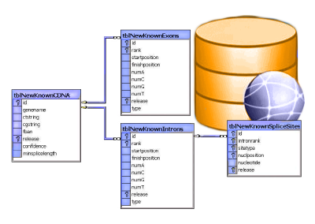
Table Relationships

Slide 15
Why Split Related Data?
Empty records
First | Last | Registered | Email
David | Rivers | 05/02/2016 | drivers@mail.cx
Sarah | Thorne | 07/17/2016 | sarah@mail.cx
Michael | Walters | 11/23/2015 | walters_michael@mail.cx
Email2
david@homedomain.cx
NULL
NULL
Redundant information
OrderID | Date | Customer | Product | S/N | Price
00315 | 07/16/2016 | David Rivers | Oil Pump | OP147-0623 | 69.90
00315 | 07/16/2016 | David Rivers | Accessory Belt | AB544-1648 | 149.99
00316 | 07/17/2016 | Sarah Thorne | Wiper Fluid | WF000-0001 | 99.90
00317 | 07/18/2016 | Michael Walters | Oil Pump | OP147-0623 | 69.90

Slide 16
Related Tables
We split the data and introduce relationships between the tables to avoid repeating information
The connection is established via a Foreign Key in one table pointing to the Primary Key in another
UserID | First | Last | Registered
203 | David | Rivers | 05/02/2016
204 | Sarah | Thorne | 07/17/2016
205 | Michael | Walters | 11/23/2015
UserID | Email
203 | drivers@mail.cx
204 | sarah@mail.cx
203 | david@homedomain.cx
205 | walters_michael@mail.cx
Primary Key
Foreign Key

Slide 17
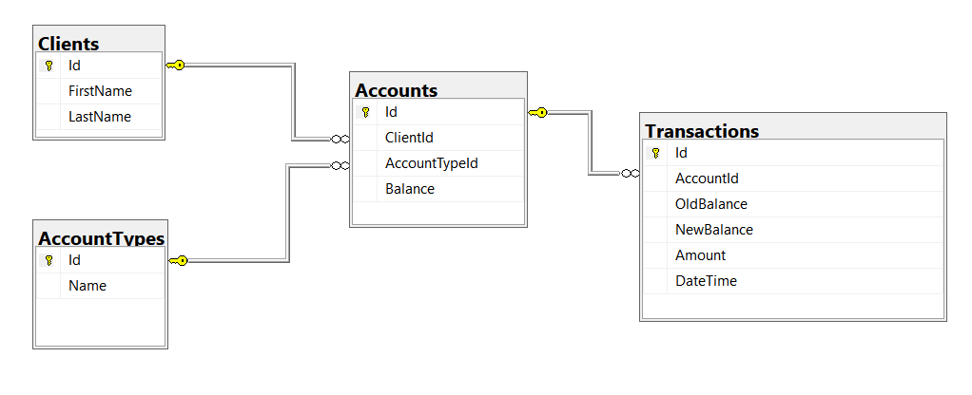
Relational Diagrams
Helps the client navigate the schema
Explaining relations between tables:

Slide 18
Programmability
Begin
?
?
Customizing Database Behavior

Slide 19
Procedures, Functions and Triggers
A database can further be customized with reusable code
Procedures – carry out a predetermined action
E.g. calculate and store the weekly revenue based on recorded sales in the database
Functions – receive parameters and return a result
E.g. get the age of a person using their birthdate and current date
Triggers – watch for activity in the database and react to it
E.g. when a record is deleted, write it to an archive

Slide 20
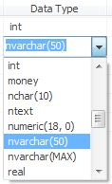

Data Types in SQL Server

Slide 21
Data Types in SQL Server
Numeric
BIT (1-bit), INT (32-bit), BIGINT (64-bit)
FLOAT, REAL, DECIMAL(scale, precision)
MONEY – for money (precise) operations
Textual
CHAR(size) – fixed size string
VARCHAR(size) – variable size string
NVARCHAR(size) – Unicode variable size string
TEXT / NTEXT – text data block (unlimited size)

Slide 22
Data Types in SQL Server (2)
Binary data
BINARY(size) – fixed length sequence of bits
VARBINARY(size) – a sequence of bits, 1-8000 bytes or MAX (2GB)
Date and time
DATE – date in range 0001-01-01 through 9999-12-31
DATETIME – date and time with precision of 1/300 sec
SMALLDATETIME – date and time (1 minute precision)

Slide 23


Database Modeling
Data Definition using SSMS

Slide 24
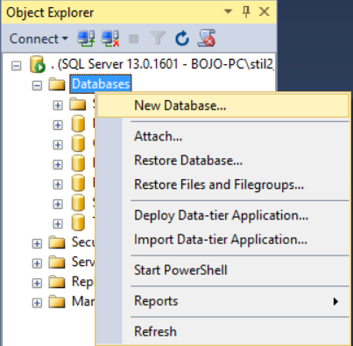
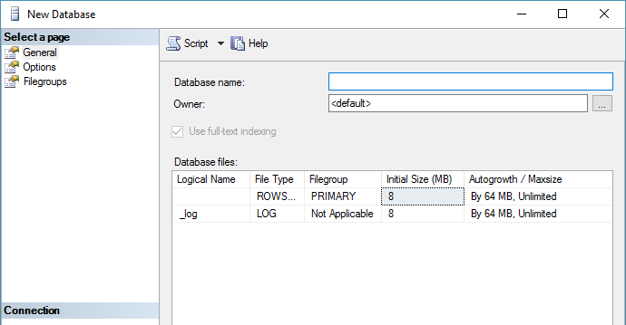
Creating a New Database
Select New Database from the context menu under "Databases"
You may need to Refresh [F5] to see the results

Slide 25
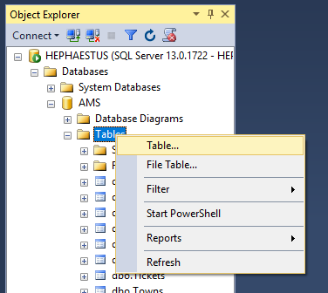
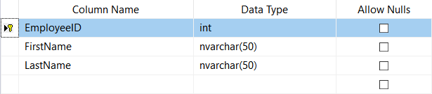
Creating Tables
From the context menu under "Tables" inside the desired database
Table name can be set from its Properties [F4] or when it is saved

Slide 26
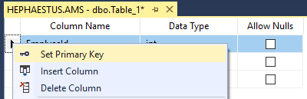
Creating Tables (2)
A Primary Key is used to uniquely identify and index records
Setting primary key on a column:

Slide 27

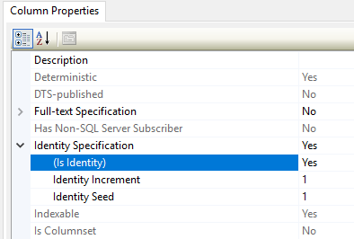
Creating Tables (3)
Identity – The value in the column is automatically incremented when a new record is added
These values cannot be assigned manually
Identity Seed – the initial number (1 by default)
Identity Increment – how much each consecutive value is incremented

Slide 28
Creating Tables (4)
Setting an identity through the "Column Properties" window:

Slide 29
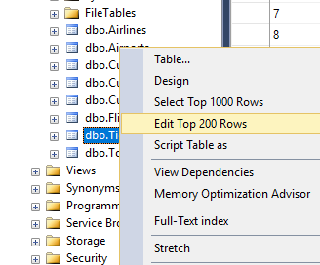
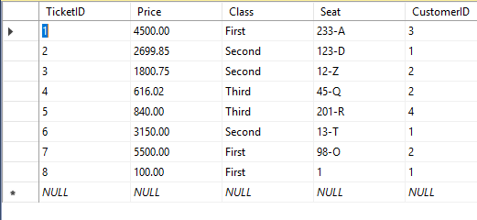
Storing and Retrieving Data
We can add, modify and read records with Management Studio
To insert or edit a record, click Edit from the context menu
Enter data at the end
to add a new row

Slide 30
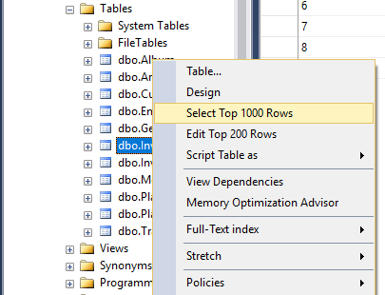
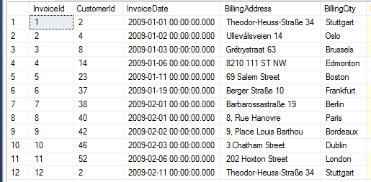
Storing and Retrieving Data (2)
To retrieve records, click Select from the context menu
The received information can be customized with SQL queries

Slide 31
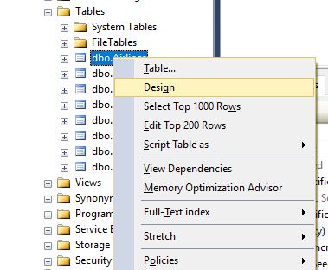
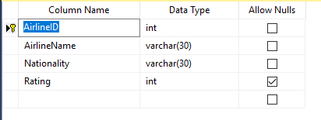
Altering Tables
You can change the properties of a table after its creation
Select Design from the table's context menu
Changes cannot conflict with existing rules!

Slide 32
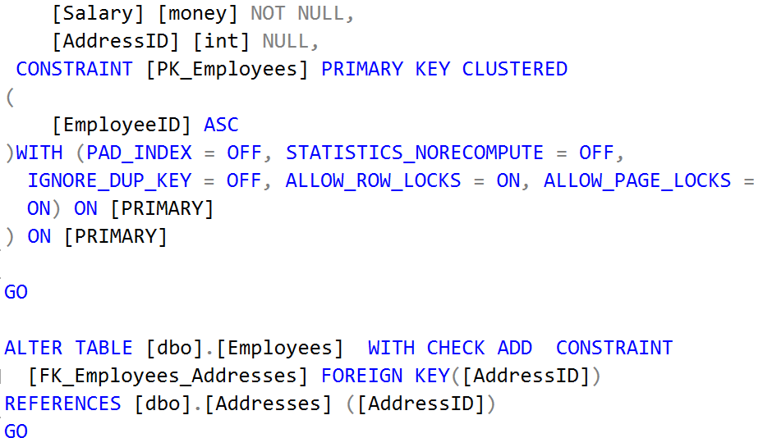
SQL Queries
Data Definition using T-SQL

Slide 33
SQL Queries
We can communicate with the database engine using SQL
Queries provide greater control and flexibility
To create a database using SQL:
SQL keywords are traditionally capitalized
Database name
CREATE DATABASE Employees

Slide 34
Table Creation in SQL
Table name
CREATE TABLE People
(
Id int NOT NULL,
Email varchar(50) NOT NULL,
FirstName varchar(50),
LastName varchar(50)
)
Custom attributes
Data type
Column name

Slide 35
Retrieve Records in SQL
To get all records from a table
You can limit the number of rows and number of columns
SELECT * FROM Employees
Number of records
List of columns
SELECT TOP (5) FirstName, LastName
FROM Employees

Slide 36

Table Customization
Adding Rules, Constraints and Relationships

Slide 37
Custom Column Properties
Primary Key
Identity (auto-increment)
Unique constraint – no repeating values in entire table
Id INT NOT NULL PRIMARY KEY
Id INT PRIMARY KEY IDENTITY
Email VARCHAR(50) UNIQUE

Slide 38
Custom Column Properties (2)
Default value – if not specified (otherwise set to NULL)
Value constraint
Balance DECIMAL(10,2) DEFAULT 0
Kelvin DECIMAL(10,2) CHECK (Kelvin > 0)

Slide 39
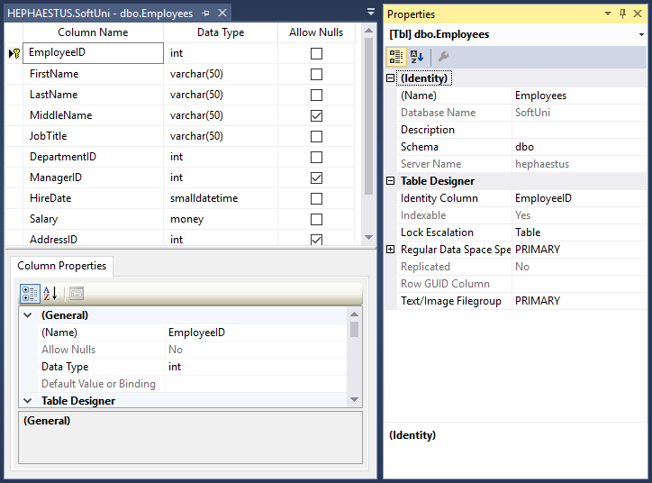
Altering Tables
Changing Table Properties After Creation

Slide 40
Altering Tables Using SQL
A table can be changed using the keywords ALTER TABLE
Adding a column
ALTER TABLE Employees
Table name
ALTER TABLE Employees
ADD Salary DECIMAL(15, 2)
Column name
Data type

Slide 41
Altering Tables Using SQL (2)
Delete existing column
Modify data type of existing column
Column name
ALTER TABLE People
DROP COLUMN FullName
ALTER TABLE People ALTER COLUMN Email VARCHAR(100)
Column name
New data type

Slide 42
Altering Tables Using SQL (3)
Constraint name
Add primary key to existing column
Add unique constraint
ALTER TABLE People ADD CONSTRAINT PK_Id
PRIMARY KEY (Id)
Column name(s)
Constraint name
ALTER TABLE People ADD CONSTRAINT uq_Email
UNIQUE (Email)
Columns name(s)

Slide 43
Altering Tables Using SQL (4)
Set default value
Add check constraint
ALTER TABLE People ADD DEFAULT 0
FOR Balance
Default value
Column name
Constraint
Name
ALTER TABLE InstrumentReadings ADD CONSTRAINT PositiveValue
CHECK (Kelvin > 0)
Condition

Slide 44
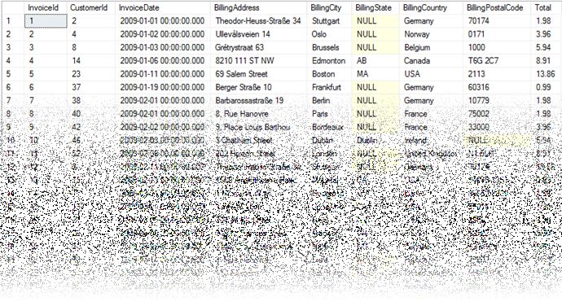
Deleting Data and Structures

Slide 45
Deleting from Database
Deleting structures is called dropping
We can drop:
Keys
Constraints
Tables
Entire databases
Deleting all data in a table is called truncating
Both of these actions cannot be undone – use with caution!

Slide 46
Dropping and Truncating
To delete all records in a table
To drop a table – delete data and structure
To drop entire database
TRUNCATE TABLE Employees
Table name
DROP TABLE Employees
Table name
DROP DATABASE AMS
Database name

Slide 47
Dropping and Truncating (2)
Removing constraint from column
This includes primary keys, check constraints and unique fields
To remove default value (if not specified, revert to NULL)
Table name
ALTER TABLE Employees DROP CONSTRAINT PK_Id
Constraint name
ALTER TABLE Employees ALTER COLUMN Clients
DROP DEFAULT
Table name
Columns name

Slide 48
Summary
RDBMS store and manage data
Table relations reduce repetition and complexity
Table columns have fixed types
We can use Management Studio to create and customize tables
SQL provides greater control over actions

